Slide 1

context API IN REACT JS

Slide 2
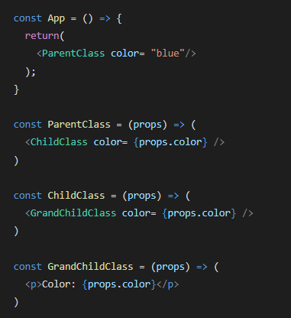
Without Context API
If GrandChildClass component was more deeply nested than it was very difficult to manage. prop drilling
This is the problem that Context solves.

Slide 3
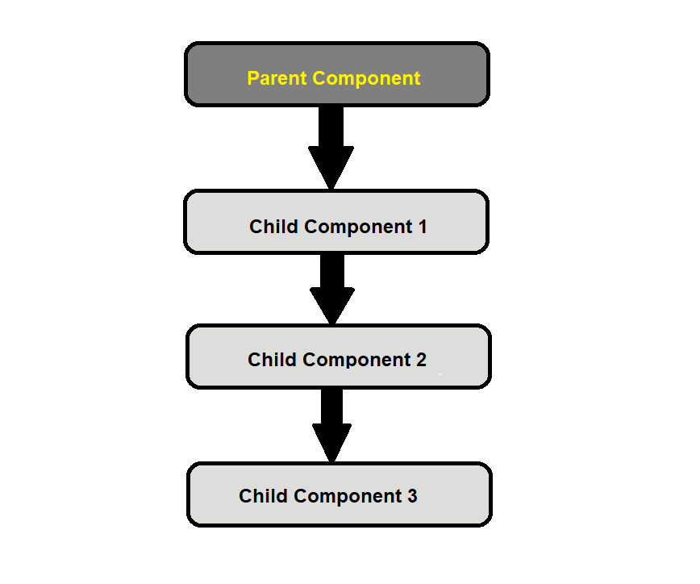
What is context api
Context is a built-in API introduced in ​​React 16.3.
It makes it possible to pass data from parent to children nested deep down the component tree directly, instead of passing it down through a chain of props.

Slide 4
Without
Context API
Parent Component
Child Component
One
Child Component Two
props.field
props.field
props.field
No Middleman
Final Component
My Provider.js
Parent Component
Child Component
One
Child Component
Two
Context API
Pass data to final component directly.

